Slide 1
Application-agnostic Data Collection Strategies for AI at the Edge
Henry Abrahamson, Yongho Kim
September 2025

Slide 2

Problem:
Consider a video-based AI job that recognizes animals run on a SAGE node in the wilderness. When we consider the constraints of this setting, running the task regularly without any change may cause problems:
Too much data is generated
Not all of it can be sent to the cloud for processing
Much of the data is irrelevant
Only some parts of the video have an animal in it
Interesting events are urgent
Other types of sensors, or even other SAGE nodes, may want to collect data from the event
Resources are scarce
In a high load / low power setting, running jobs at all times may not be feasible

Slide 3
Problem:
Consider a video-based AI job that recognizes animals run on a SAGE node in the wilderness. When we consider the constraints of this setting, running the task regularly without any change may cause problems:
Too much data is generated

Slide 4
Problem:
Consider a video-based AI job that recognizes animals run on a SAGE node in the wilderness. When we consider the constraints of this setting, running the task regularly without any change may cause problems:
Too much data is generated
Much of the data is irrelevant

Slide 5
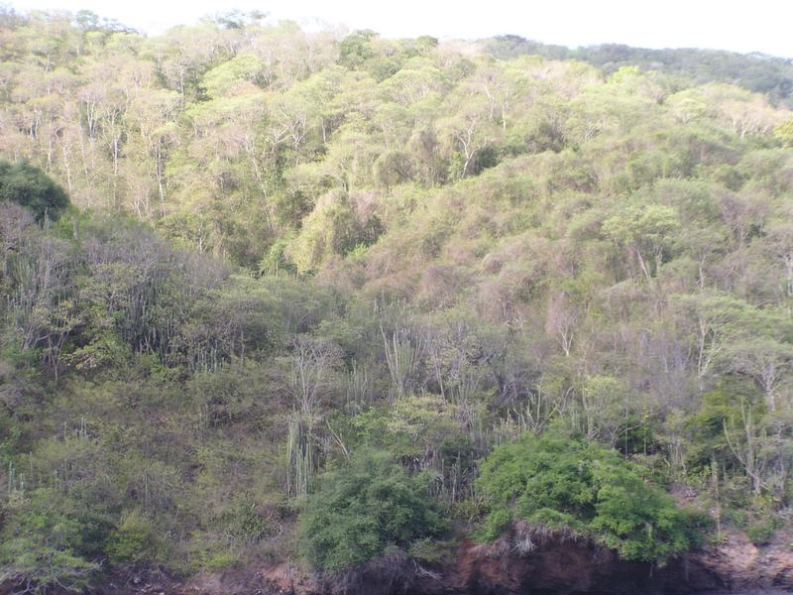
Problem:
Consider a video-based AI job that recognizes animals run on a SAGE node in the wilderness. When we consider the constraints of this setting, running the task regularly without any change may cause problems:
Too much data is generated
Much of the data is irrelevant
Interesting events are urgent

Slide 6
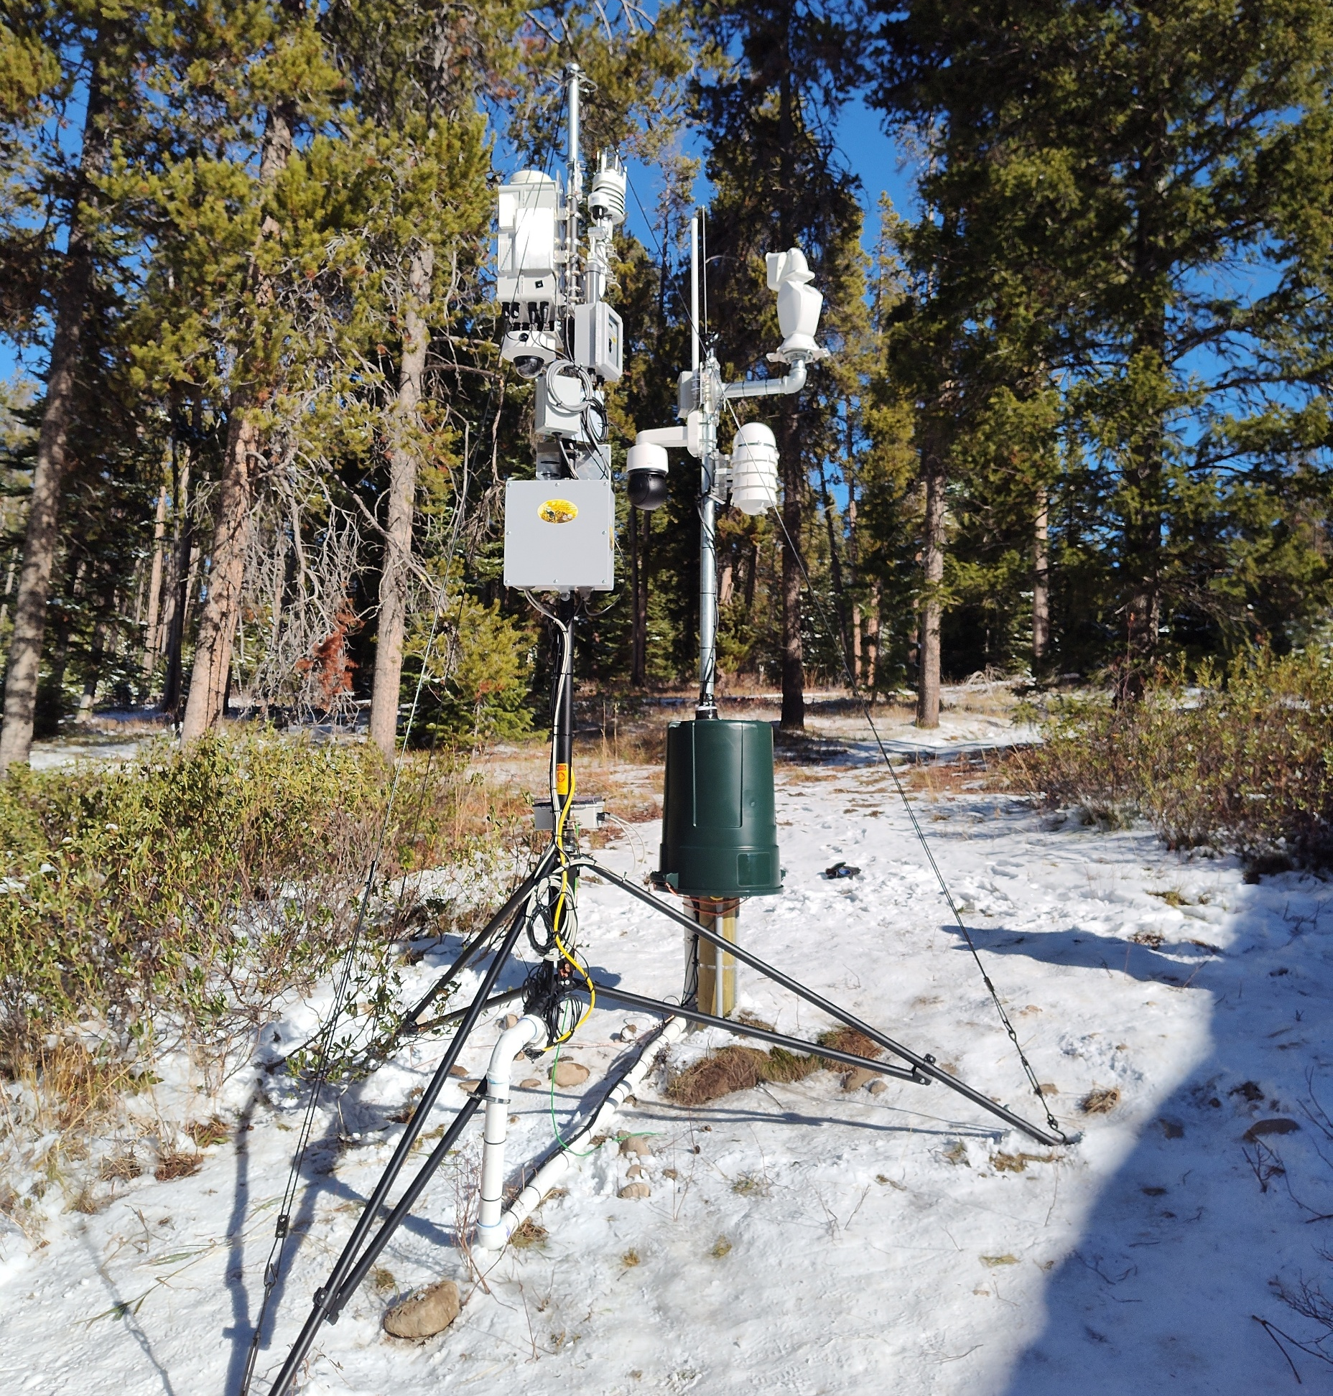
Problem:
Consider a video-based AI job that recognizes animals run on a SAGE node in the wilderness. When we consider the constraints of this setting, running the task regularly without any change may cause problems:
Too much data is generated
Much of the data is irrelevant
Interesting events are urgent
Resources are scarce

Slide 7
Goal:
Devise a framework for dynamic data collection strategies at the edge. This framework should be:
General – no application-specific dependencies
At-the-edge – only relies on local decision-making
1. Design a simulator to be used for testing & exploration
2. Apply a real use case to the simulator and collect metrics
3. Deploy a strategy designed using our framework to a SAGE node

Slide 8
Goal:
Devise a framework for dynamic data collection strategies at the edge. This framework should be:
General – no application-specific dependencies
At-the-edge – only relies on local decision-making
Environment
Strategy
1. Design a simulator to be used for testing & exploration
2. Apply a real use case to the simulator and collect metrics
3. Deploy a strategy designed using our framework to a SAGE node

Slide 9
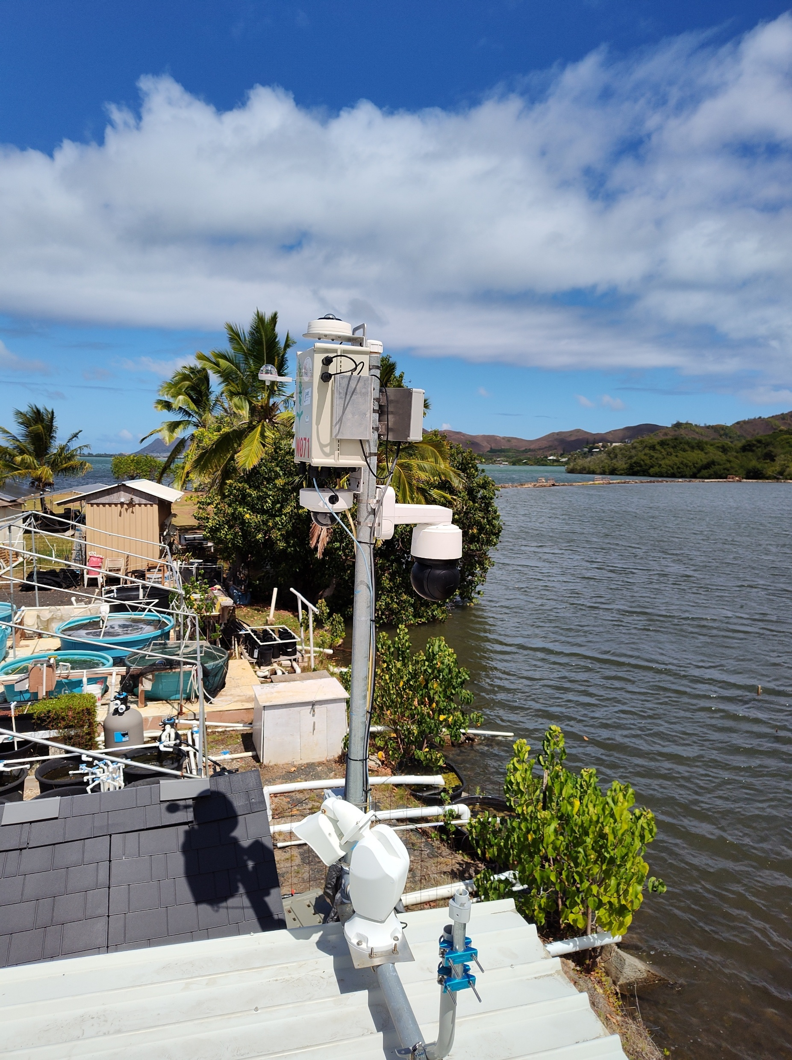
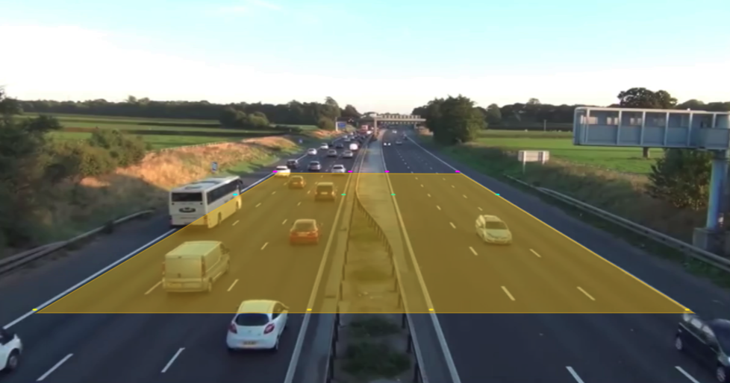
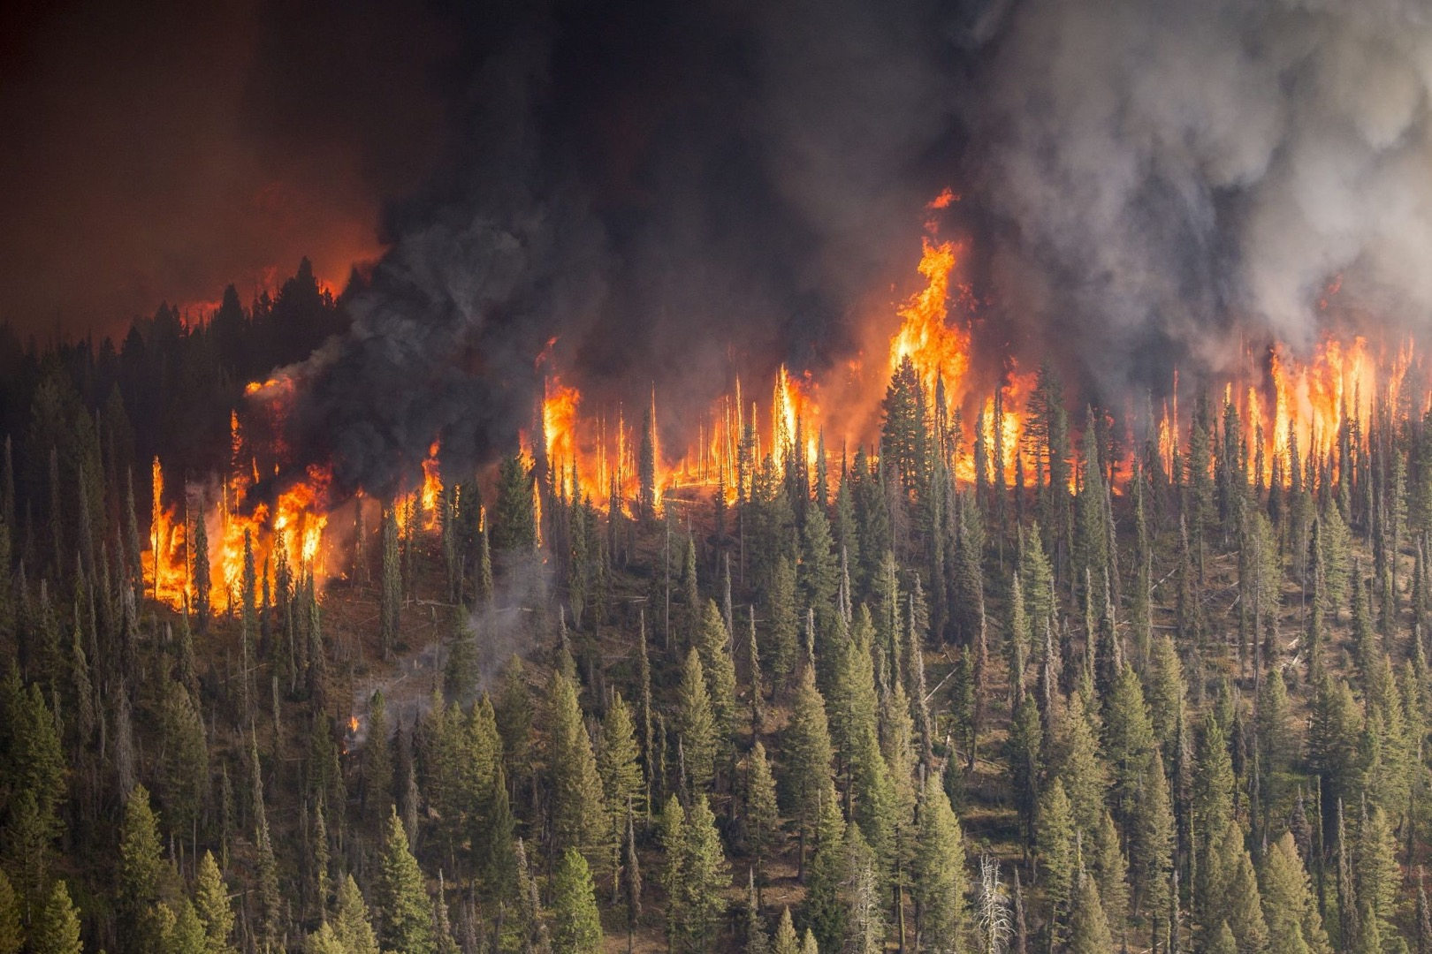
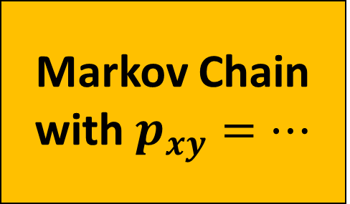
Environmental Model
Markov Chain with $p_{xy}=…$
Environment
Event occurs between x & y hours…

Slide 10
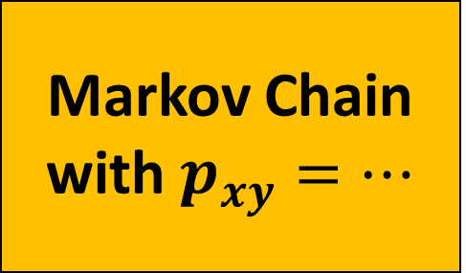
Strategy Model
Markov Chain with Memory State
Markov Chain with $p_{xy}=…$
Strategy
Up samples between x & y hours
Event occurs between x & y hours…

Slide 11
Step 1: Proof of Concept Simulator
Strategy 1
Strategy 2
Strategy 3
…
Data Quality
(total amount of relevant data collected)
Simulation
Data Efficiency
(ratio of relevant vs irrelevant data collected)
Environment 1
Environment 2
Environment 3
…

Slide 12
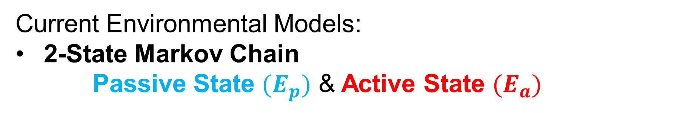
Step 1: Proof of Concept Simulator
Current Environmental Models:
2-State Markov Chain Passive State $(E_{p})$ & Active State $(E_{a})$
5%
5% Relevant, 95% Irrelevant
90% Relevant, 10% Irrelevant
1%

Slide 13
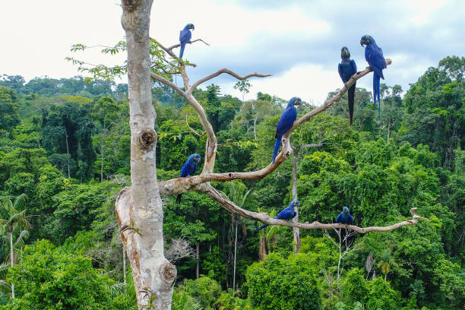

Step 1: Proof of Concept Simulator
Current Environmental Models:
2-State Time Correlations Passive State $(E_{p})$ & Active State $(E_{a})$
0h-3h
3h-4h
4h-6h
5% Relevant, 95% Irrelevant
90% Relevant, 10% Irrelevant
5% Relevant, 95% Irrelevant

Slide 14
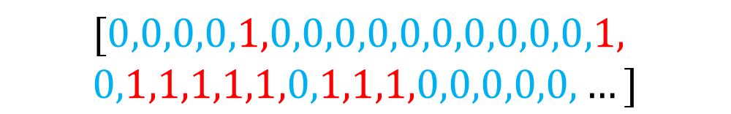
Step 1: Proof of Concept Simulator
Current Environmental Models:
Preloaded Samples
e.g., with 1 = Relevant sample, 0 = Irrelevant sample,
$$[0,0,0,0,1,0,0,0,0,0,0,0,0,0,0,1, \\ 0,1,1,1,1,1,0,1,1,1,0,0,0,0,0,…]$$

Slide 15
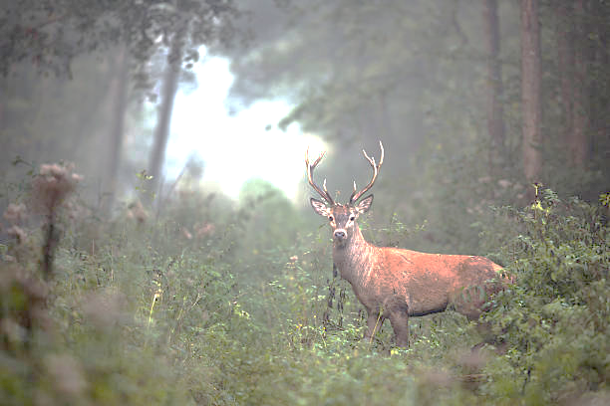

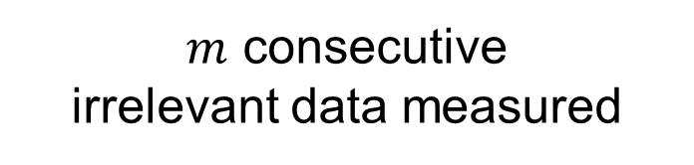
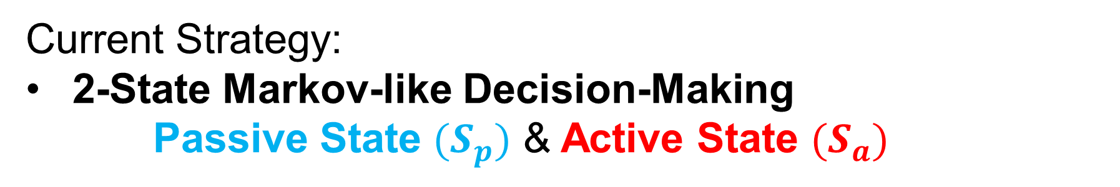
Step 1: Proof of Concept Simulator
Current Strategy:
2-State Markov-like Decision-Making Passive State $(S_{p})$ & Active State $(S_{a})$
$m$ consecutive irrelevant data measured
Higher Quality Measurements
Passive / Irrelevant Sensing
Active / Relevant Sensing
More Frequent Measurements
Relevant data measured

Slide 16
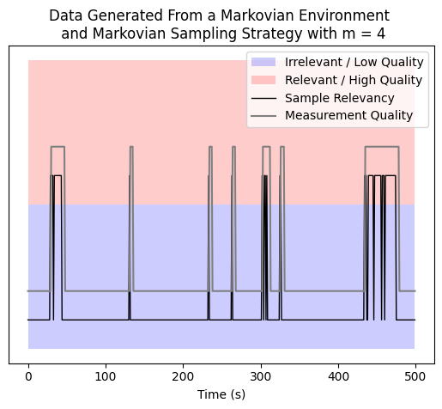
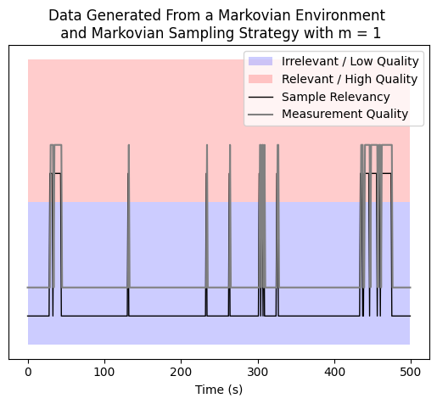
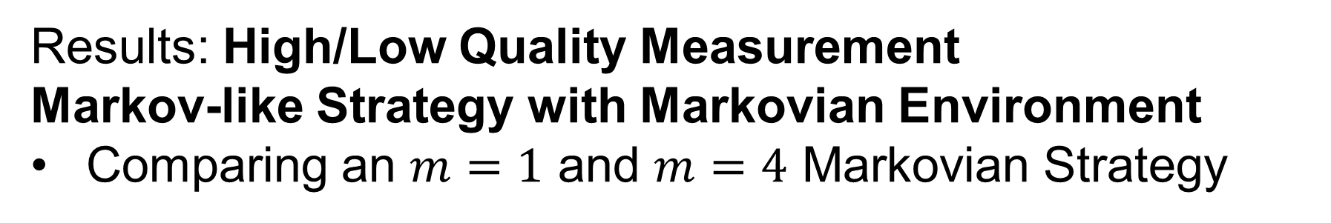
Step 1: Proof of Concept Simulator
Results: High/Low Quality Measurement Markov-like Strategy with Markovian Environment
Comparing an $m=1$ and $m=4$ Markovian Strategy

Slide 17
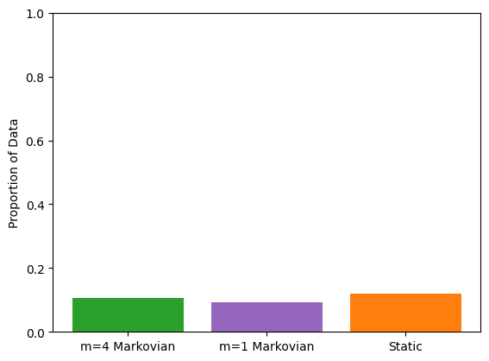
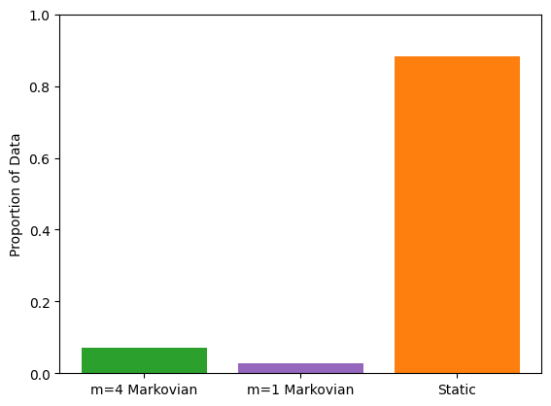
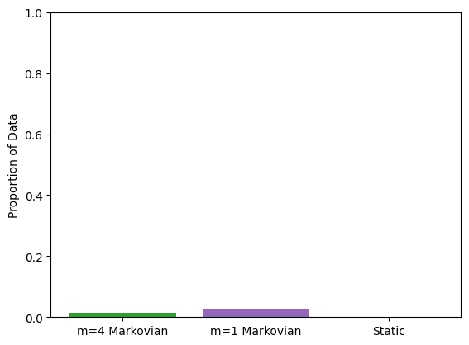
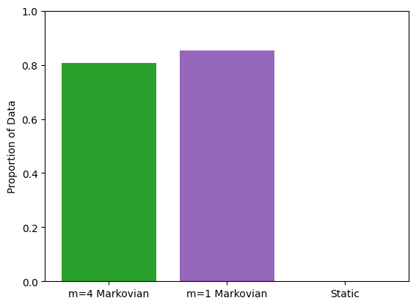
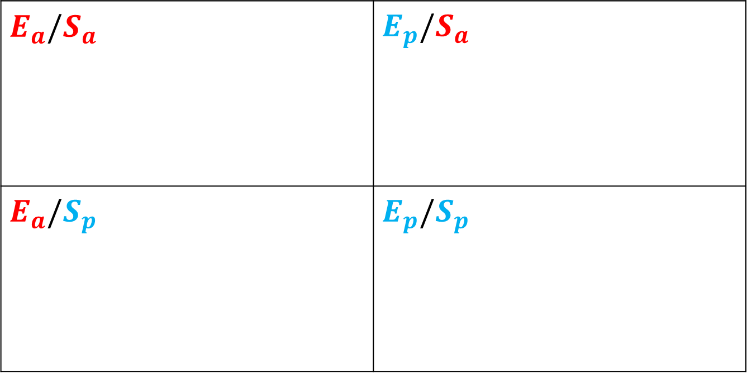
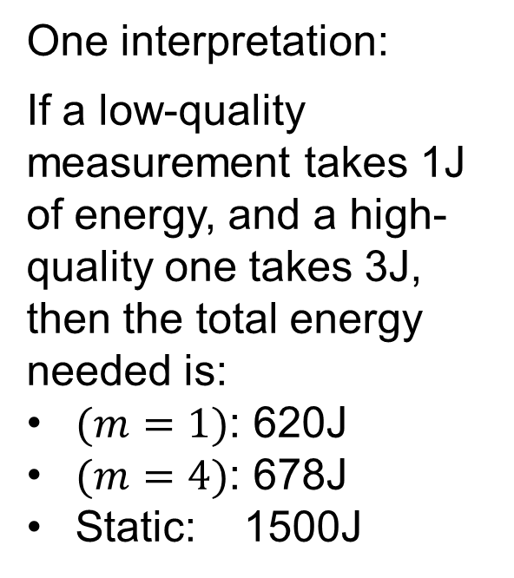
Step 1: Proof of Concept Simulator
Results: High/Low Quality Measurement Markov-like Strategy with Markovian Environment
Comparing Markovian strategies against a static strategy
$$E_{a}/S_{a}$$ | $$E_{p}/S_{a}$$
$$E_{a}/S_{p}$$ | $$E_{p}/S_{p}$$
One interpretation:
If a low-quality measurement takes 1J of energy, and a high-quality one takes 3J, then the total energy needed is:
$(m=1)$: 620J
$(m=4)$: 678J
Static: 1500J

Slide 18
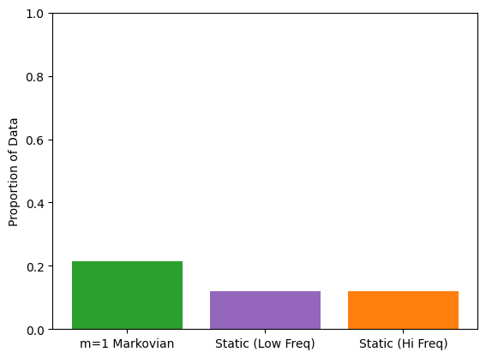
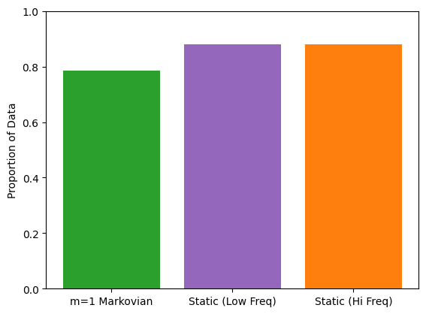
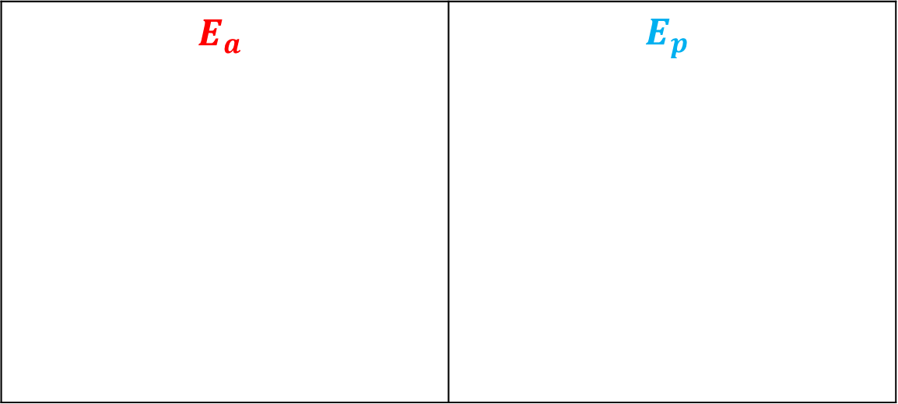
Step 1: Proof of Concept Simulator
Results: High/Low Frequency Markov-like Strategy with Markovian Environment
Low Frequency: 1/sec
High Frequency: 2/sec
$$E_{a}$$ | $$E_{p}$$

Slide 19
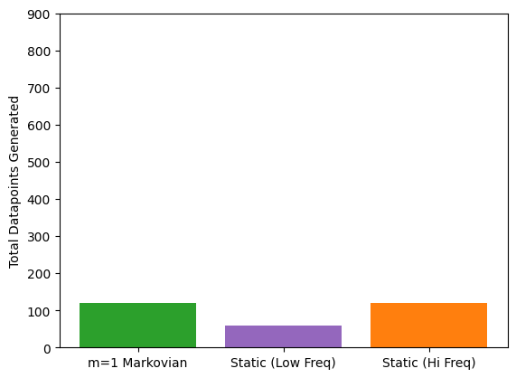
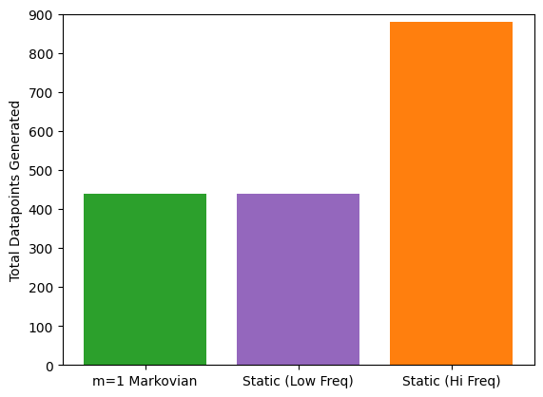
Step 1: Proof of Concept Simulator
Results: High/Low Frequency Markov-like Strategy with Markovian Environment
Low Frequency: 1/sec
High Frequency: 2/sec
The Markovian strategy generates 2x as much relevant data as the static strategy at low frequency.
The Markovian strategy generates 0.56x as much total data as the static strategy at high frequency.
$$E_{a}$$ | $$E_{p}$$

Slide 20
What’s Next?
We are currently looking for a good dataset that is (hopefully) prelabelled, and which would be appropriate for a job that can be run on a SAGE node and tested.
Based on that dataset & job, we might build new models for the environment & strategy.
2. Apply a real use case to the simulator and collect metrics
3. Deploy a strategy designed using our framework to a SAGE node

